Slide 1
Software Architecture
Module 5
Ensuring conformance to architecture
Harvinder S Jabbal
SEZG651/SSZG653 Software Architectures

Slide 2
Code may drift away from Architecture
Examples of drift:
Not sticking to the discipline of layers – an object in one layer calling an object located in a layer beyond the adjacent layer
Accessing data base directly without going through data access layer
Notifying different modules one by one instead of using ‘publish – subscribe’ model,
Not making use of a common logging mechanism, etc.
What other architecture violations have you come across?
March 2, 2024
SEZG651/SSZG653 Software Architectures

Slide 3
Techniques to keep the code and architecture consistent
Embed design concepts in the code (Architecturally evident coding style)
Use frameworks
Use code templates
Update architecture documentation
March 2, 2024
SEZG651/SSZG653 Software Architectures

Slide 4
Embed design in code
Follow ‘Architecturally Evident Coding Style’
Indicate in the code, aspects of architecture being implemented. Example:
  If we are using a layered architecture, indicate to which layer the code belongs
  If we are using ‘Publish – Subscribe’ pattern, indicate in the code whether it belongs to Publisher or Subscriber
  If we are using Message queues (MQ) for communication between components, indicate what the component is doing - inserting message or retrieving message from the MQ.
March 2, 2024
SEZG651/SSZG653 Software Architectures

Slide 5
Use Frameworks
Examples of frameworks:
Spring
Hibernate
Autosar - AUTomotive Open System Architecture
March 2, 2024
SEZG651/SSZG653 Software Architectures

Slide 6
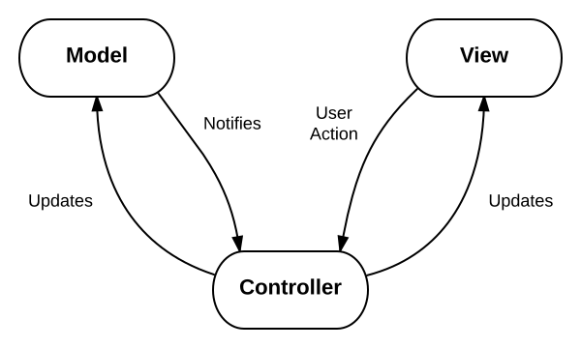
Spring MVC Framework
Supports Model-View-Controller framework
Here code belongs to one of the 3 component types - Model, View or Controller
  Model encapsulates the application data
  View renders screens on browser
  Controller processes user requests, interacts with Model components and passes information to View components for rendering
March 2, 2024
SEZG651/SSZG653 Software Architectures

Slide 7
Experience sharing
Can you give examples of other frameworks that you have used?
March 2, 2024
SEZG651/SSZG653 Software Architectures

Slide 8
Other examples of frameworks
Publish – Subscribe framework (JMS)
Workflow framework of SalesForce.com
Rules engine (DROOLS)
Logging framework - Log4J (for logging events)
March 2, 2024
SEZG651/SSZG653 Software Architectures

Slide 9
Use Code templates
A template provides a structure for developers to code
For example a template for developing a code that needs to be fault tolerant will have the following sections in the template
    Get event
    Case (Event type)
      Normal: // received by primary process
        Process X; Send state to backup process;
        Process Y; Send state to backup process;
      Update State data: // received by Backup process
        Update state data;
      Switch over: // received by Backup process
        Notify clients about change in Primary process;
    End case;
Code needs to be accommodated in this template
March 2, 2024
SEZG651/SSZG653 Software Architectures

Slide 10
Update architecture documentation
Changes to code should be accompanied with changes to architecture document when applicable
At least mark parts of the arch document that is no longer applicable as ‘No longer applicable’. This increases trust on remainder of the document
Technique: At release time, synchronize the arch doc with code.
March 2, 2024
SEZG651/SSZG653 Software Architectures

Slide 11
Exercise
What other techniques can we think of to ensure that code does not drift away from architecture?
March 2, 2024
SEZG651/SSZG653 Software Architectures

Slide 12
Exercise
What other techniques can we think of to ensure that code does not drift away from architecture?
  Educate new team members about the architecture
  Do Code reviews
  Create folders for each architectural aspect such as layer, service, UI, external interfaces, etc. and follow a discipline of storing the code in respective folders
March 2, 2024
SEZG651/SSZG653 Software Architectures

